Slide 1
Briefing House Education Educational Service Districts
January 15, 2019
Notes:
NOTE:
To change the image on this slide, select the picture and delete it. Then click the Pictures icon in the placeholder to insert your own image.

Slide 2
Questions for today:
What is the function of ESDs, including their general duties and reporting requirements?
When were they established?
How were they established?
Where is the authority for their functions?

Slide 3
History of Washington ESDs
1854 | Office of the County Superintendent was created by statute
1909 | County Boards of Education were created with duties in statute
1955 | County board memberships changed to elected lay membership
1969 | Legislature passed Intermediate School District Act. State Board created 14 Intermediate School Districts
1969-1977 | A decade of legislative actions resulted in consolidating 14 service areas to the present nine ESDs
1981 | Legislation passed to allow ESDs to provide direct student services

Slide 4
Purpose of ESDs – RCW28A.310.010
ESDs are considered a political sub-division of the state and are statutorily designed to:
Provide cooperative and informational services to local school districts
Assist the Superintendent of Public Instruction and the State Board of Education in the performance of their respective constitutional duties
Provide services to school districts to assure equitable educational opportunities for ALL students

Slide 5
Governance at Individual ESDs
Each ESD is governed by a Board of Directors, elected by school board members of the school districts in the ESD region, for a term of four years
Each ESD has a Superintendent’s Advisory Council that approves the annual budget and makes recommendations for ESD service and support
Each ESD Cooperative is governed by an Advisory Council mad up of Superintendents in the region (RCW 28A.310.430)

Slide 6
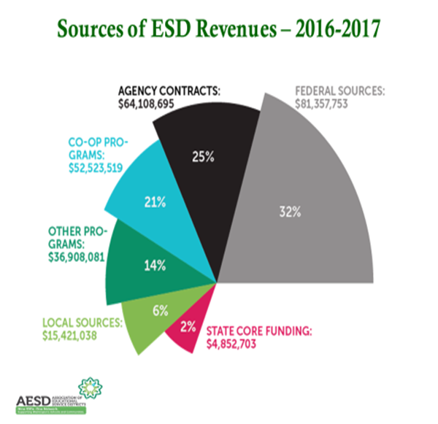
Adding Economical Value to Washington Education
ESDs leveraged $5.1 million of state allocated core funding into $251 million of needed services for students and schools in Washington.
For every $1 in core funding, ESDs returned $49 in educational programs and services - $230 for every student in the state.

Slide 7
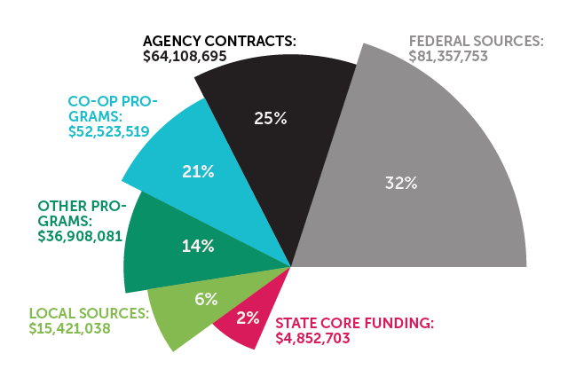
Sources of ESD Revenues: 2016 - 2017

Slide 8
Some of the Services Provided by ESDs:
School construction services
WSIPC (Washington School Information Processing Cooperative)
Teacher/staff leadership professional development with a focus on equity and closing identified opportunity gaps
Program evaluation services
Administrative services
Operations, fiscal, and technical services
Special education coordination
Grant acquisition and grants management
Communications and planning support
Early Learning technical assistance
Technology, computer, and climate science training
Student system and student learning support
Accreditation services
School Safety/Mental Health Centers

Slide 9
Leading With Racial Equity

Slide 10
PSESD END:
Success for Each Child & Eliminate the Opportunity Gap by leading with Racial Equity

Slide 11
Internal Work
PSESD Racial Equity Policy implementation
Alignment of Board policies to Antiracist Multicultural Organization
Transformation Team
Caucusing
Success for Each Child & Eliminate the Opportunity Gap by leading with Racial Equity

Slide 12
Regional Work
Collaboration with Road Map school districts
Racial Equity Policy development
Diversifying the educator workforce
Reduce discipline disparity
Educator capacity building
Family and Community engagement framework development
Leadership support
Early Learning
Success for Each Child & Eliminate the Opportunity Gap by leading with Racial Equity

Slide 13
Statewide Work
Partnerships
Washington Association of Community and Technical Colleges
Community College Presidents’ Retreat
State Board of Education
Washington State School Directors’ Association
Washington State Charter School Commission
Success for Each Child & Eliminate the Opportunity Gap by leading with Racial Equity

Slide 14
Educational Service Districts: In Service of Equity and Opportunity for ALL Students
Notes:
NOTE:
To change the image on this slide, select the picture and delete it. Then click the Pictures icon in the placeholder to insert your own image.

Slide 15
Following slides for reference only

Slide 16
RCW 28A.310.010
Purpose.
It shall be the intent and purpose of this chapter to establish educational service districts as regional agencies which are intended to:
(1) Provide cooperative and informational services to local school districts;
(2) Assist the superintendent of public instruction and the state board of education in the performance of their respective statutory or constitutional duties; and
(3) Provide services to school districts and to the Washington state center for childhood deafness and hearing loss and the school for the blind to assure equal educational opportunities.

Slide 17
RCW 28A.310.340
Identification of core services for budget purposes—Generally.
It is the intent of the legislature that a basic core of uniform services be provided by educational service districts and be identified in statute so that biennial budget requests for educational service districts may be based upon measurable goals and needs. Educational service districts as noted in RCW 28A.310.010, are intended primarily to:
(1) Provide cooperative and informational services to local districts and to perform functions for those districts when such functions are more effectively or economically administered from the regional level;
(2) Assist the state educational agencies, office of superintendent of public instruction and the state board of education in the legal performance of their duties; and
(3) Assist in providing pupils with equal educational opportunities.

Slide 18
RCW 28A.310.430
Local school district superintendents to advise board and superintendent.
The superintendents of all local school districts within an educational service district shall serve in an advisory capacity to the educational service district board and superintendent in matters pertaining to budgets, programs, policy, and staff.

Slide 19
RCW 28A.310.470
Delegation to ESD of SPI program, project or service—Contract.
The superintendent of public instruction may delegate to any educational service district or combination of educational service districts all or any portion of a program, project, or service authorized or directed by the legislature to be performed by the superintendent of public instruction: PROVIDED, That any such delegation shall be by contract pursuant to chapter 39.34 RCW, as now or hereafter amended.

Slide 20
RCW 28A.310.480
Delegation to ESD of state board of education program, project or service—Contract.
The state board of education may delegate to any educational service district or combination of educational service districts all or any portion of a program, project, or service authorized or directed by the legislature to be performed by the state board of education: PROVIDED, That any such delegation shall be by contract pursuant to chapter 39.34 RCW, as now or hereafter amended.

