Slide 1
The Intersection of Youth and Mental Health Needs
A discussion of school-based mental health service delivery models in Educational Service Districts across Washington State
Notes:
2017 HYS Valid Responses & Rate
6th Grade N=9722 (77%)
8th Grade N=8662 (80%)
10th Grade N=10835 (70%)
12th Grade N=7590 (409%)
Please use the following guidance when reviewing your results:
• 70% or greater participation–Results are probably representative of students in this grade.
• 40–69% participation–Results may be representative of students in this grade.
• Less than 40% participation–Results are likely not representative of students in this grade but do reflect students who completed the survey.

Slide 2
DEPRESSION
Notes:
Question: During the past 12 months, did you ever feel so sad or hopeless almost every day for two weeks or more in a row that you stopped doing some usual activities. Yes/No response.
Across grade levels and survey years, findings show that the percentage of youth who report depressive feelings has increase since 2012.

Slide 3
CONSIDERED SUICIDE
Notes:
Question: During the past 12 months, did you ever seriously consider attempting suicide? Yes/No response.
Finding indicate that the percentage of youth who consider attempting suicide has risen somewhat among 10th and 12th graders, while remaining stable at the 8th grade level.

Slide 4
MADE A PLAN
Notes:
Question: During the past 12 months, did you make a plan about how you would attempt suicide? Yes/No response.

Slide 5
ATTEMPTED SUICIDE
Notes:
Question: During the past 12 months, how many times did you actually attempt suicide? Response: 0 times, 1 time, 2-3 time, 4-5 times, 6 or more times.
Extrapolated statewide these number represent approximately 6769 8th graders, and 8452 10th graders == or 15221 8th/10th students. (12th grade response rate too low to be representative)
In 2016 – 3.8% of 8th graders, 4.4% of 10th graders, and 3.8% of 12th graders reported 2 or more attempts.

Slide 6
SUICIDE IDEATION/ATTEMPT (6TH GRADE)
Notes:
Question: Have you ever seriously thought about killing yourself? Yes/No response.
Question: Have you ever tried to kill yourself? Yes/No response.
In 2016, an estimated 11,915 6th graders reported suicide ideation and 3,917 attempted suicide.

Slide 7
AWARENESS/LITERACY
Notes:
Question: Last year, did you hear or see information at your school about the warning signs of suicide and how to get help for yourself or a friend.
Response: Yes, No, Not Sure.

Slide 8
ADULT SUPPORT
Notes:
Question: When you feel sad of hopeless, are there adults that you can turn to for help?
Response: I never feel sad or hopeless; Yes; No; Not Sure.
Slide looks at % that report No/Not Sure.

Slide 9
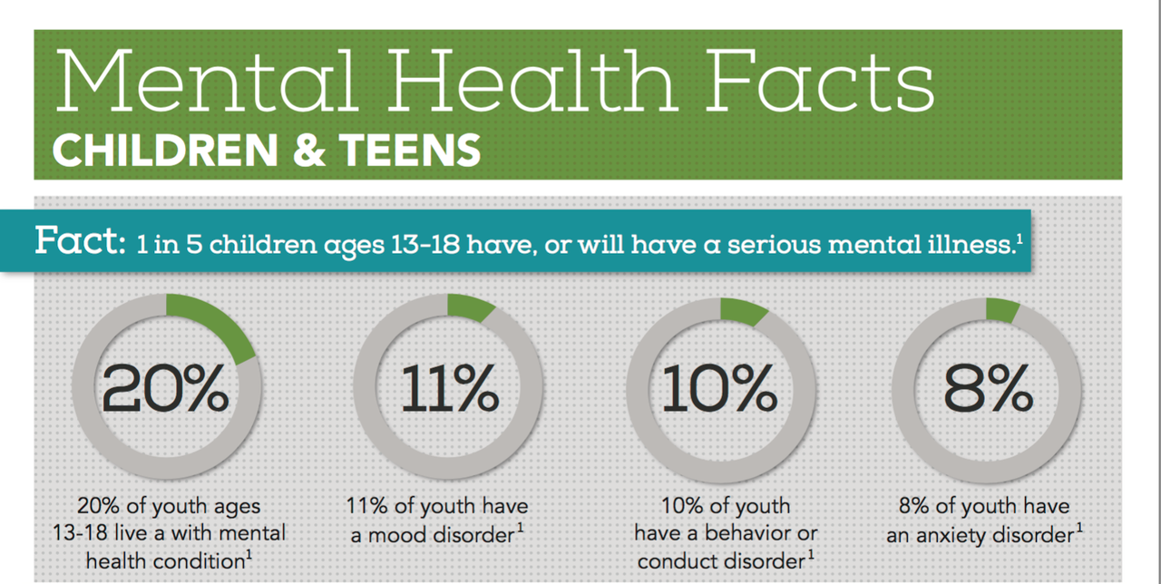
WHY WE CARE….

Slide 10
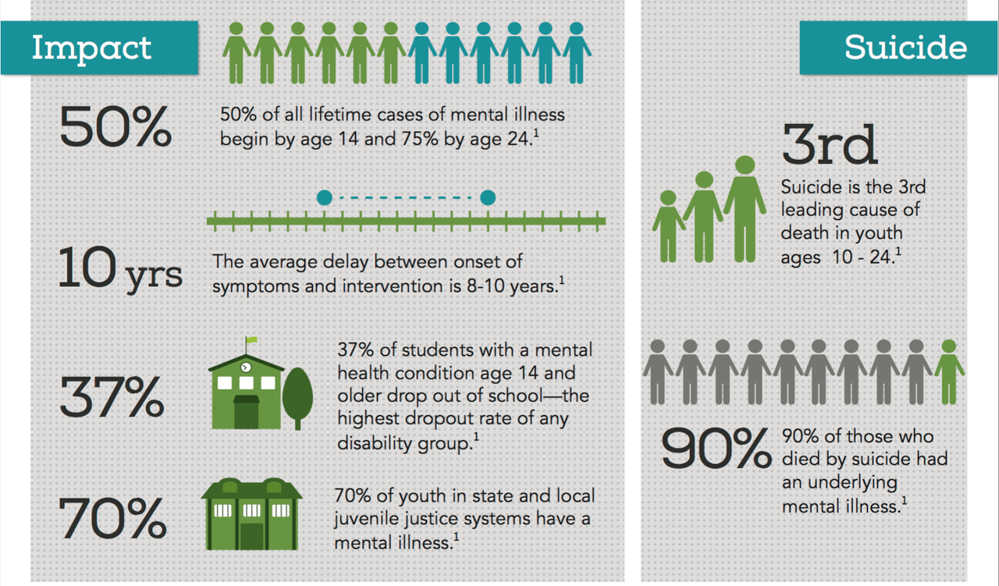
WHY WE CARE….

